Slide 1
HOTEL
Prepared For :
REZA MADABADI
Prepared By: (TEAM_2)
RAM BABU JONUBOYENA (1893718)
BHARATH VAMSHI YAMALA (1893763)
VINOD KUMAR KASTALA (1893125)
SANDEEP REDDY DONTIREDDY (1892897)

Slide 2
Goal or Purpose:
We are providing the hotels based on the season
Our main purpose to develop this application is to eradicate the customer’s confusion by providing hotel which is suitable for the particular season

Slide 3
Users:
We have better user interface than the other apps, which makes us unique in this field for providing all the requirements to the users
The applications which are existing doesn’t bother about the seasons they provide the combined hotels which makes confusion to the users

Slide 4
Stake Holders:
Mainly the people who travel a lot is our target.
They will be using our application for booking temporary stay in the hotel.

Slide 5
Competition:
These are some of the hotel booking apps which are running successfully in market today
Make my trip – Made by Deep Karla
Trivago – Made by Stephan ,Malte Siewert , Rolf , Peter.

Slide 6
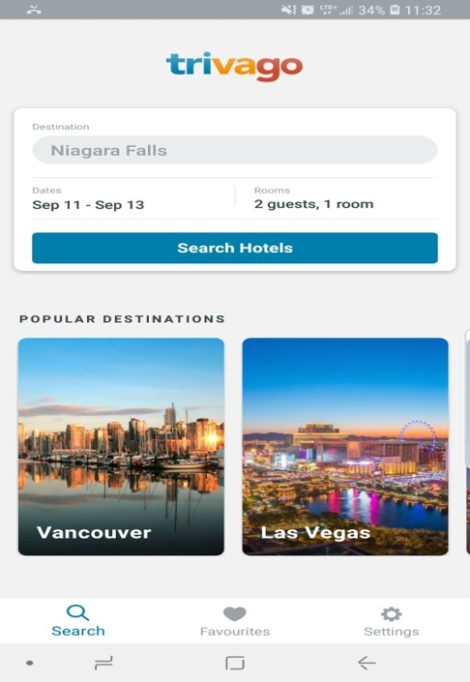
Trivago:
Trivago has clustered presence the application is
Crowded with lots of competitors because
of it the desired Hotel couldn’t be found easily.

Slide 7
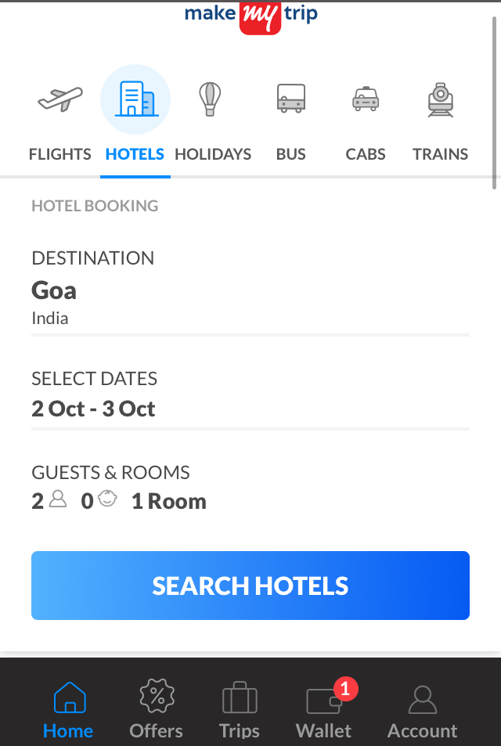
Make My Trip:
This app provides other sources to the user
which looks clumsy and may confuse the users.

Slide 8
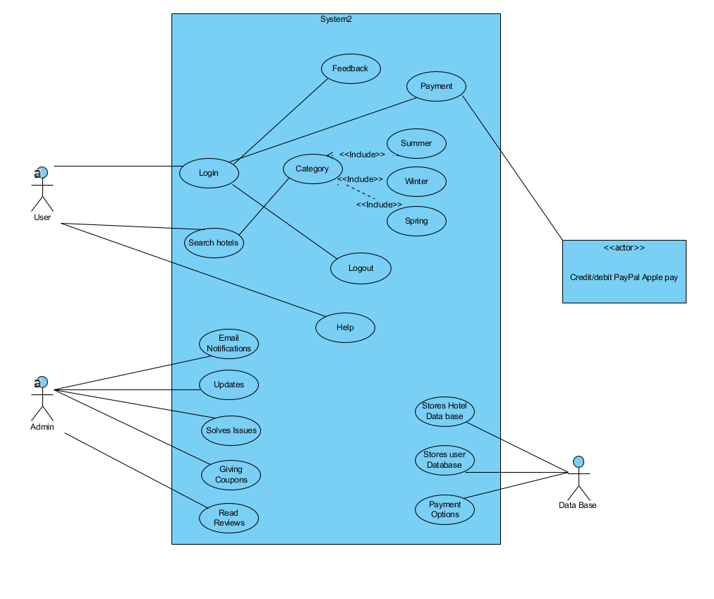
Uml Diagrams: Use Case

Slide 9
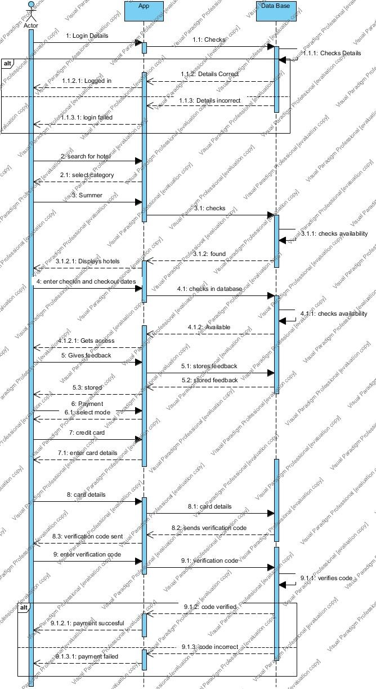
Sequence Diagram:

Slide 10
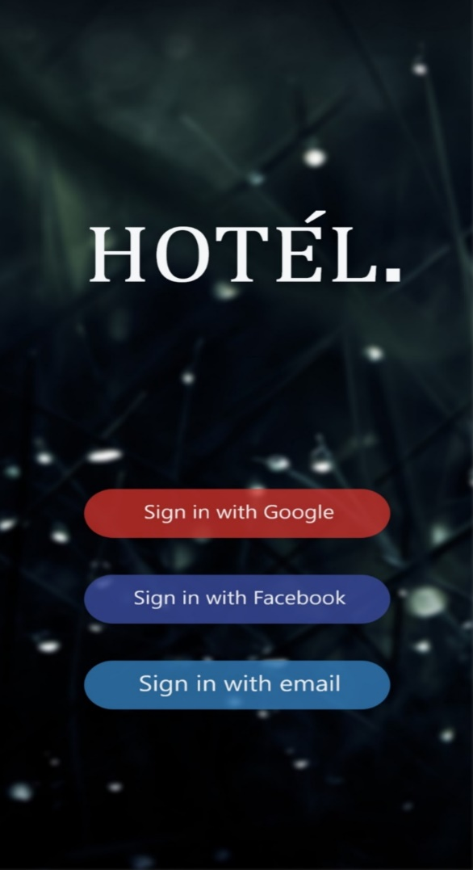
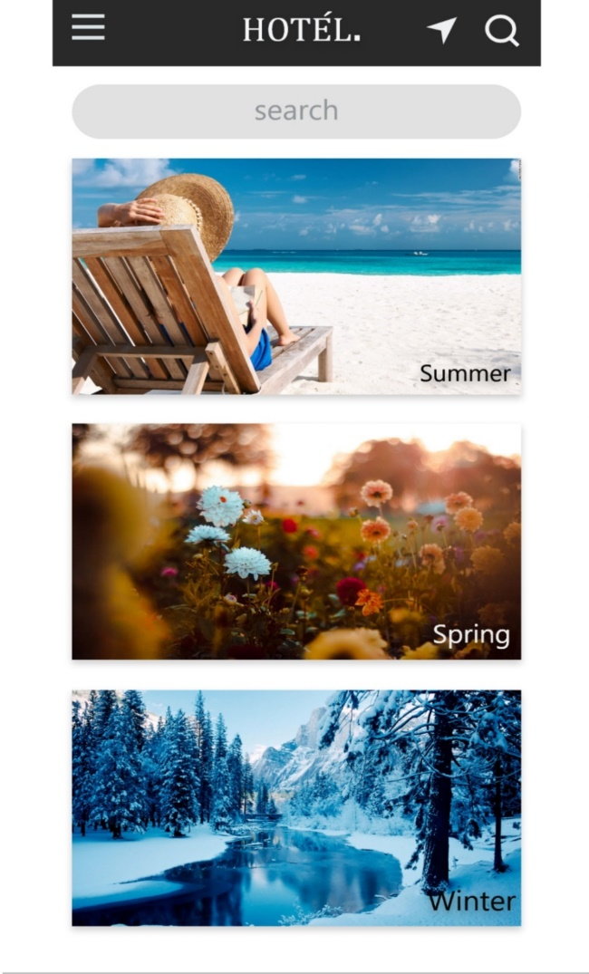
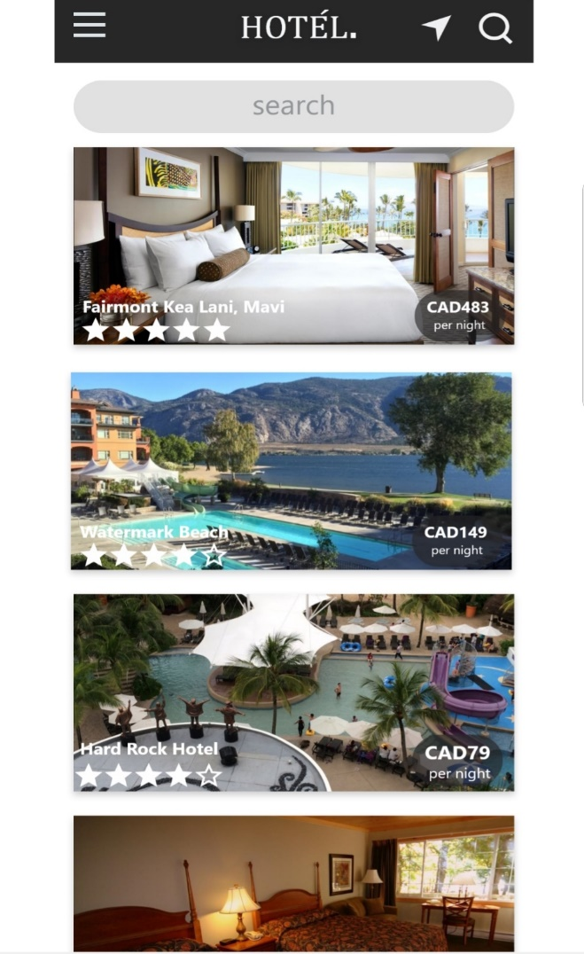
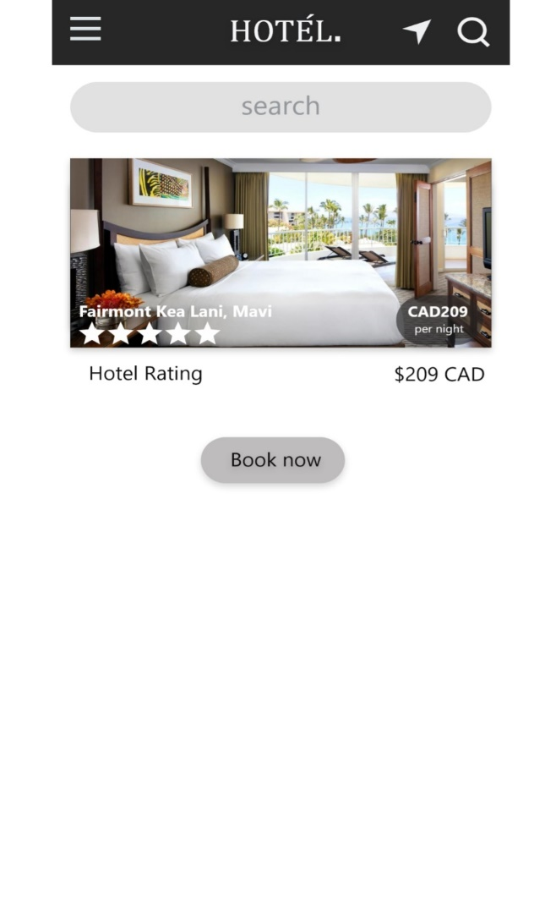
Screen flow:

Slide 11
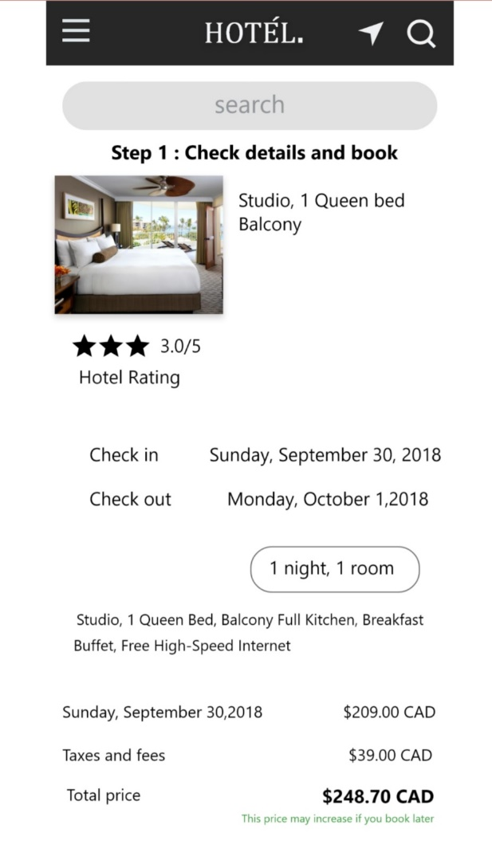
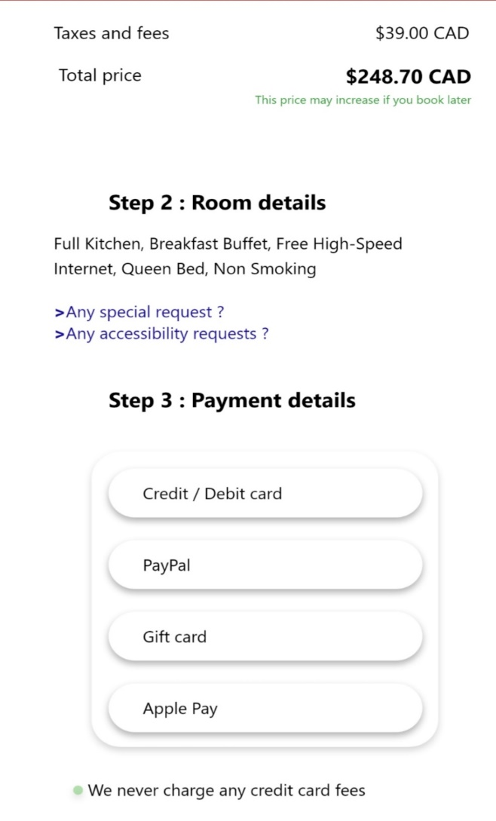
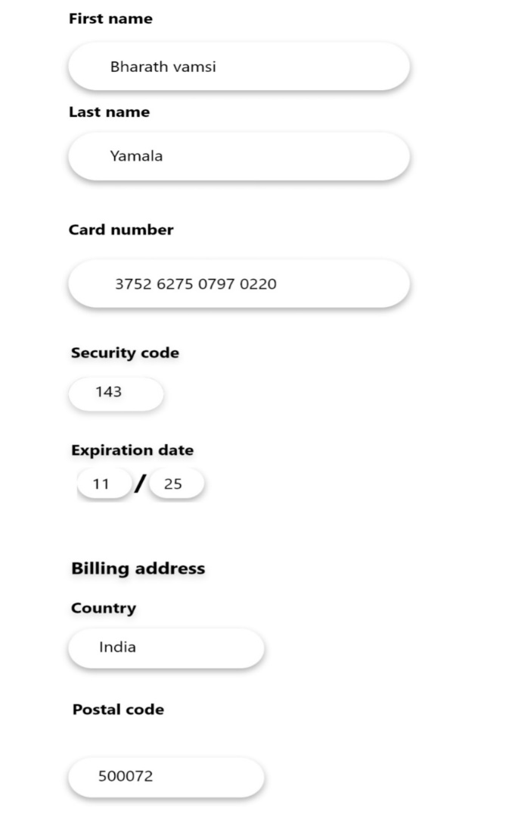
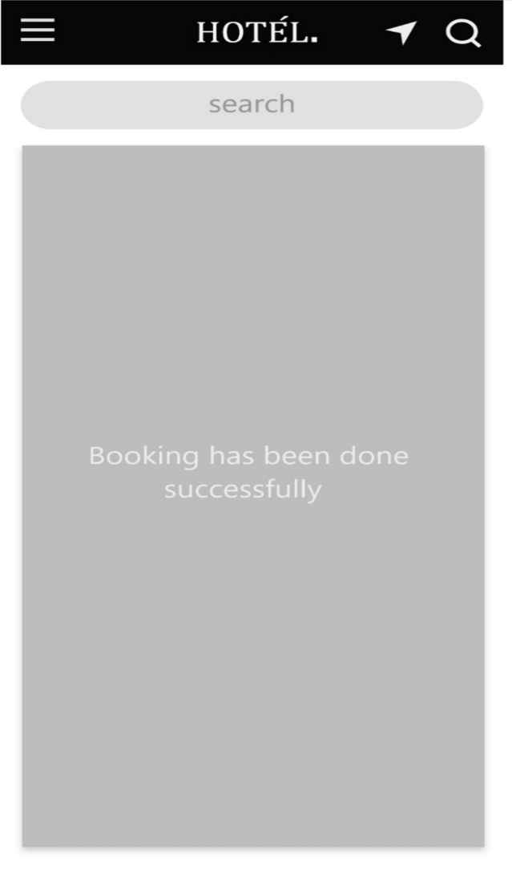

Slide 12
Thank You…

